Slide 1
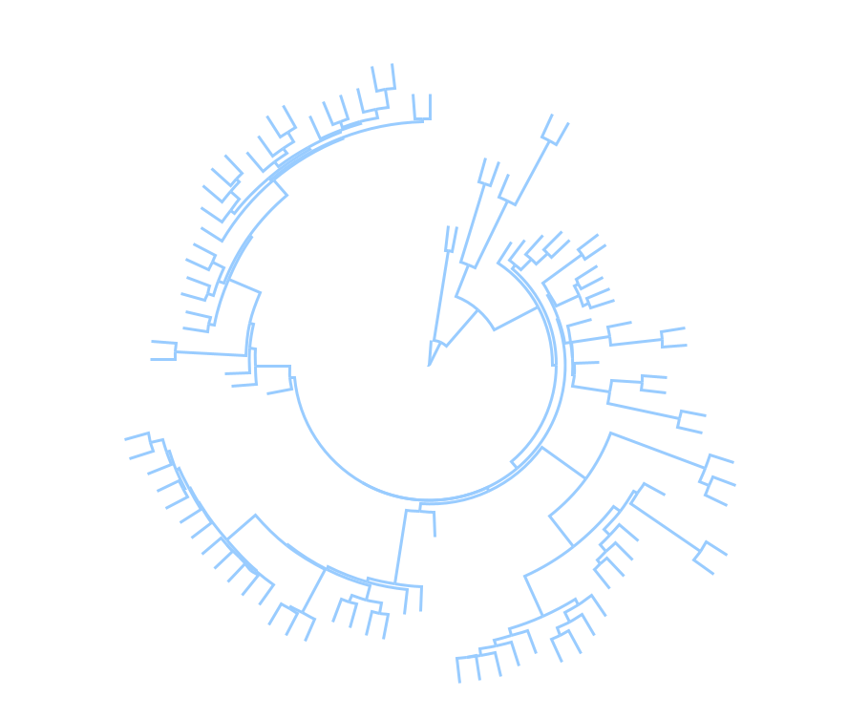
Biodiversity data wrangling: Linking large phylogenies with species traits and ecologies
Module: Macroevolution
Carolina Siniscalchi
Botany 2022

Slide 2
Macroevolution
Evolution above the species level (e.g., clade level)
Large trends and transformations in evolution:
Radiation of flowering plants
Appearance of specific traits, e.g., nitrogen fixation
Mutation
Genetic drift
Gene flow
Natural selection
+
Time
MACRO
EVOLUTION
=
Microevolutionary processes

Slide 3
Macroevolution
Some processes that are commonly studied in macroevolutionary studies:
☠️
🌲
🌴
🌳
SPECIATION
EXTINCTION
CHARACTER CHANGE
🌲
❄️
🔥
🌳
🌴
🌧
TRAIT/ENVIRONMENT INTERACTIONS

Slide 4
Macroevolution
Phylogenies are fundamental parts of macroevolutionary studies!
They provide a comparative framework in which we organize the information about the study organism
We can extraction valuable information from the phylogenetic trees themselves (e.g., diversification rates, divergence times)
🌲
🌳
🌧
❄️
🌴
🔥

Slide 5
Macroevolution
What this talk ISN’T about:
How to assemble sequence data
How to get a phylogenetic tree, comparison of methods, orthologs and paralogs, gene tree discordance, etc
How to date your tree or do biogeographical analysis
Philosophical discussions about macroevolution and criticism of methods
How to write code

Slide 6
Macroevolution
What this talk IS about:
Give a user perspective of basic steps on macroevolutionary analysis, including:
Types of data that are frequently used in macroevolutionary studies
How to organize your data and get it ready for analysis
Some examples of analysis that combine phylogenetic, environmental and trait data

Slide 7
Macroevolution
Step One: The Tree

Slide 8
Step One: The Tree
Not a pdf with a tree figure on it
We need a text-style file that R (and other programs/languages) can understand
Newick (.tre, .tree, .nwk) or nexus (.nex)

Slide 9
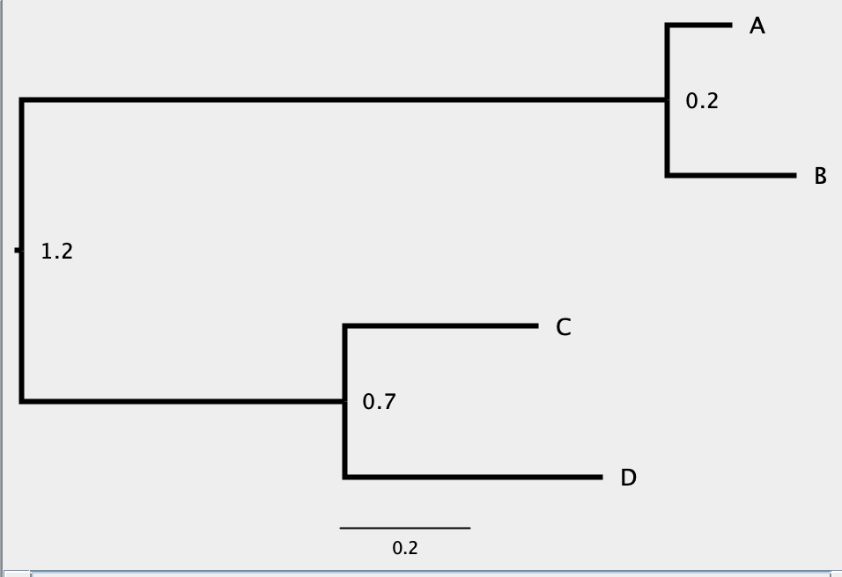
Step One: The Tree
((A:0.1,B:0.2),(C:0.3,D:0.4):0.5);

Slide 10
Step One: The Tree
Methods that involve diversification rates need trees that are:
dated, ultrametric
fully bifurcating (no polytomies)
Some methods are sensitive to sampling, so the completeness of your tree should be considered

Slide 11
Macroevolution
Step Two: Environmental Data

Slide 12
Step Two: Environmental Data
First things first: we need to know where our species of interest are found
Geographical records!
Where to find them?

Slide 13
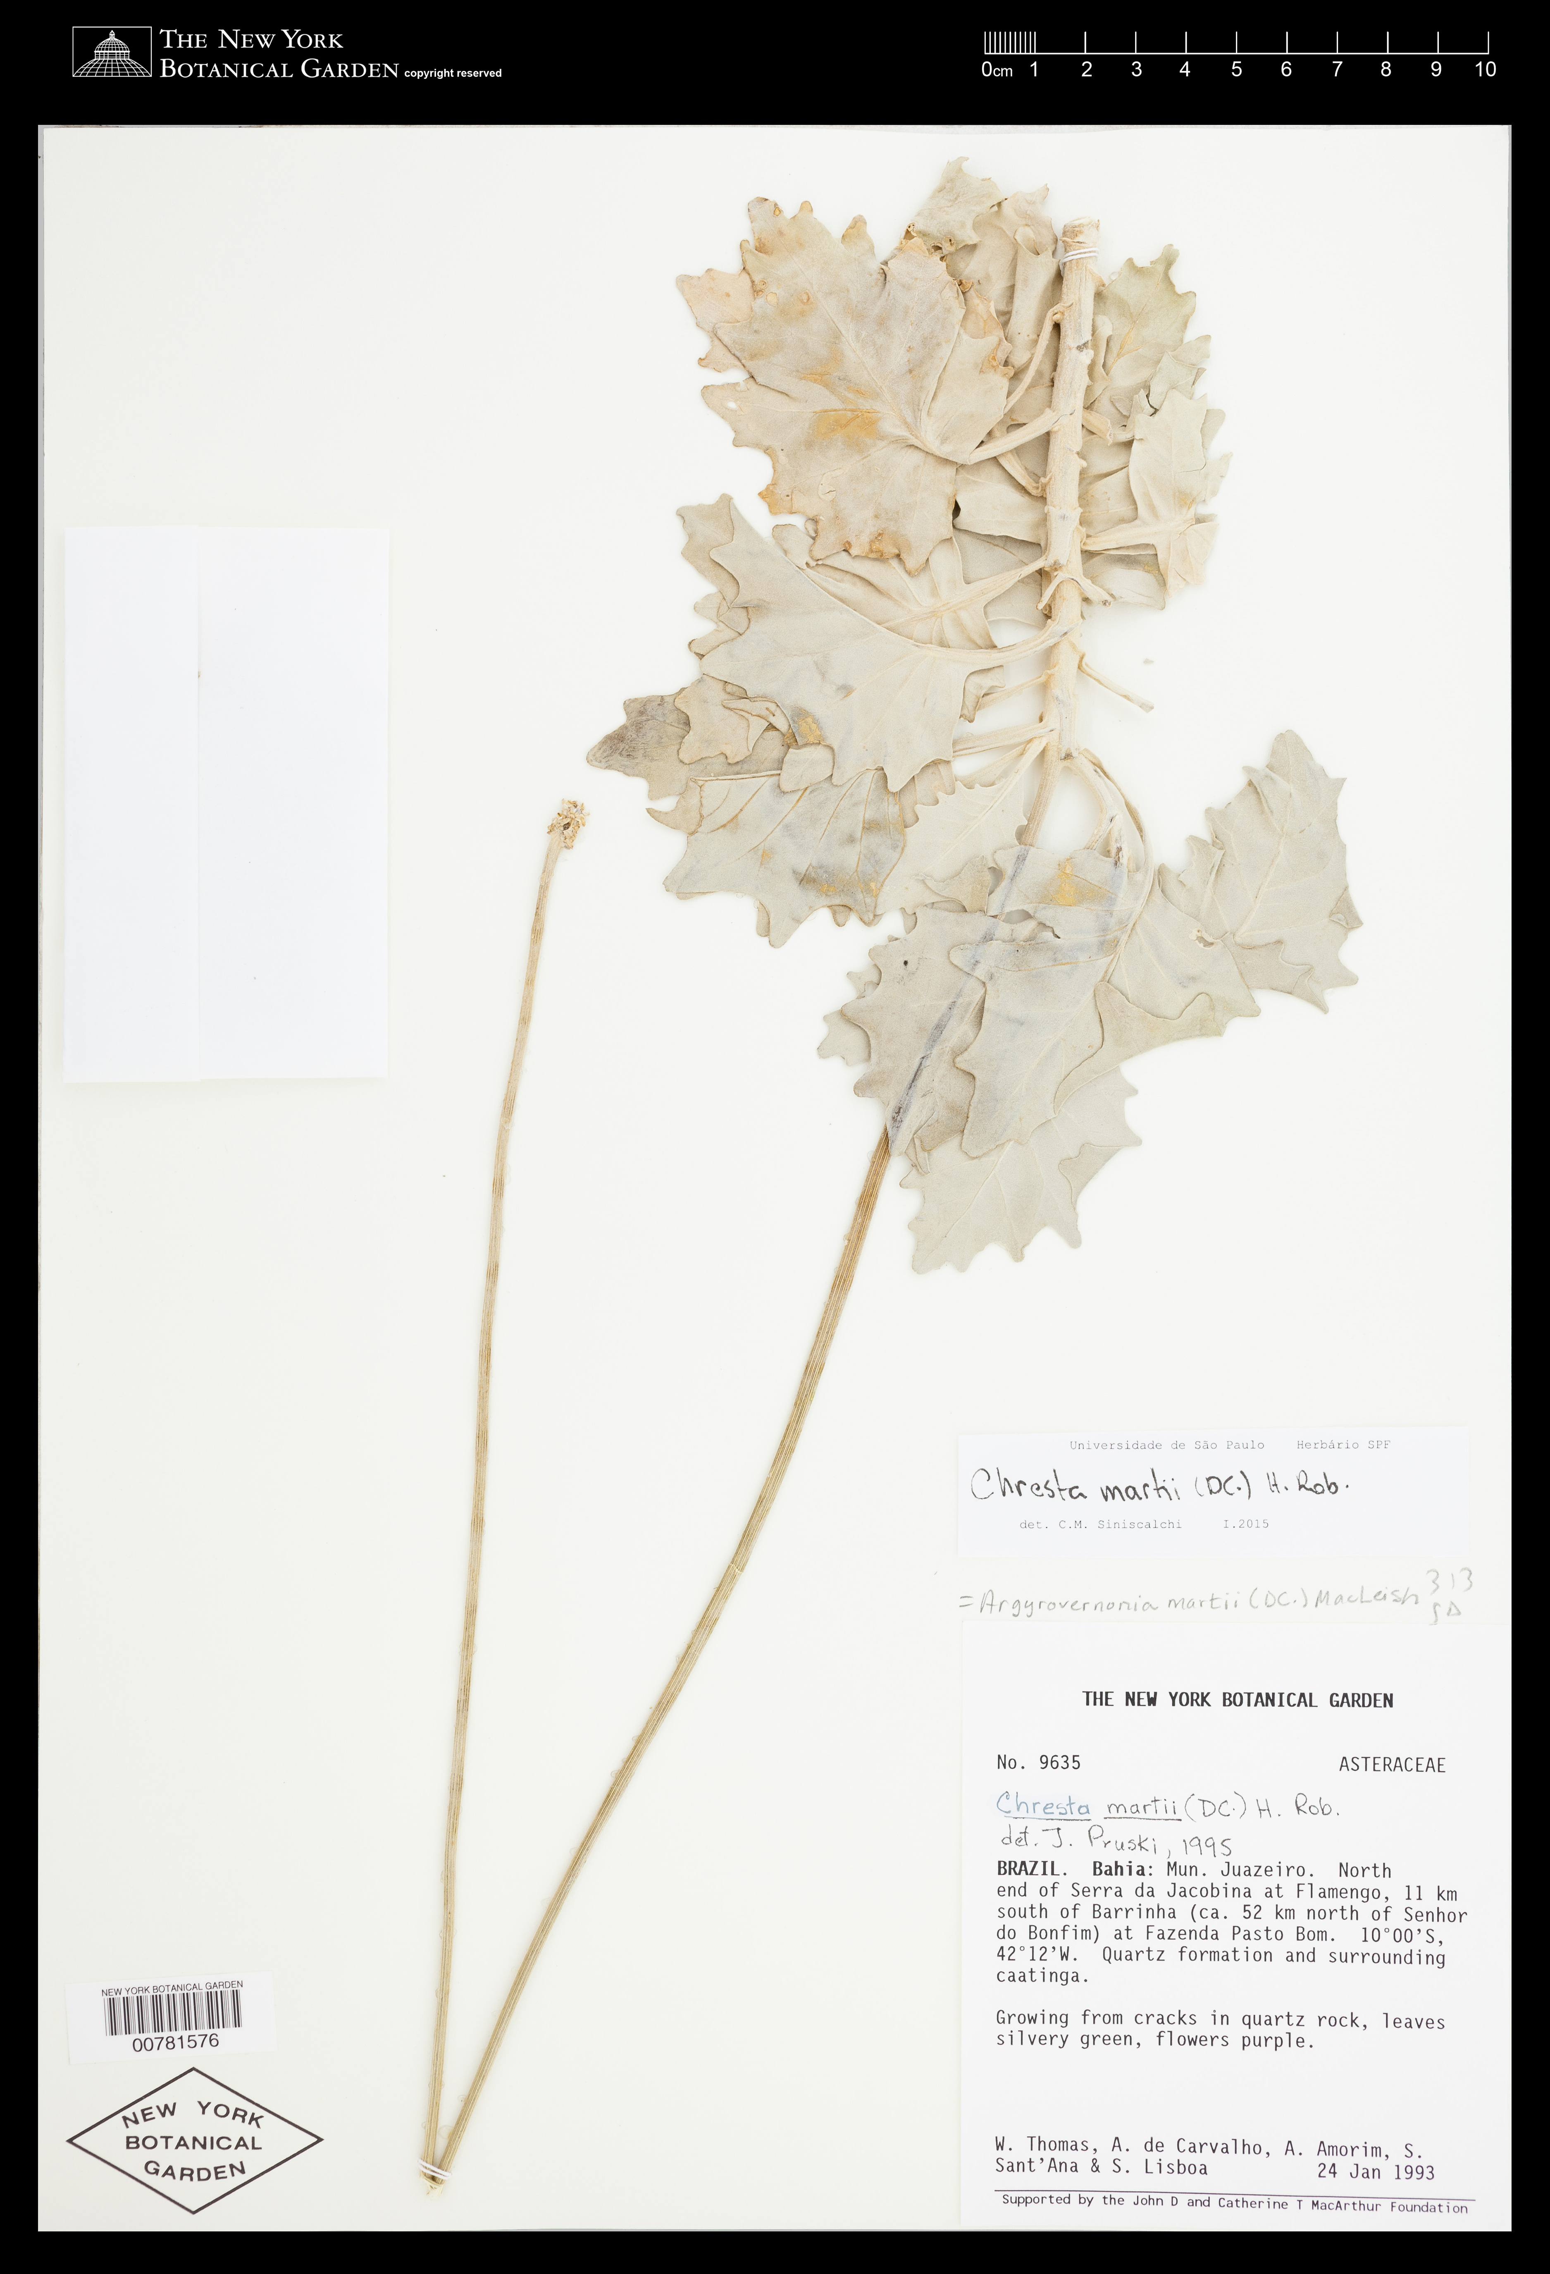
Step Two: Environmental Data
How to obtain geographical records:
1) herbarium specimens
- coordinates on the specimen
- georeferencing based on location (manually or with tools like GeoLocate)

Slide 14
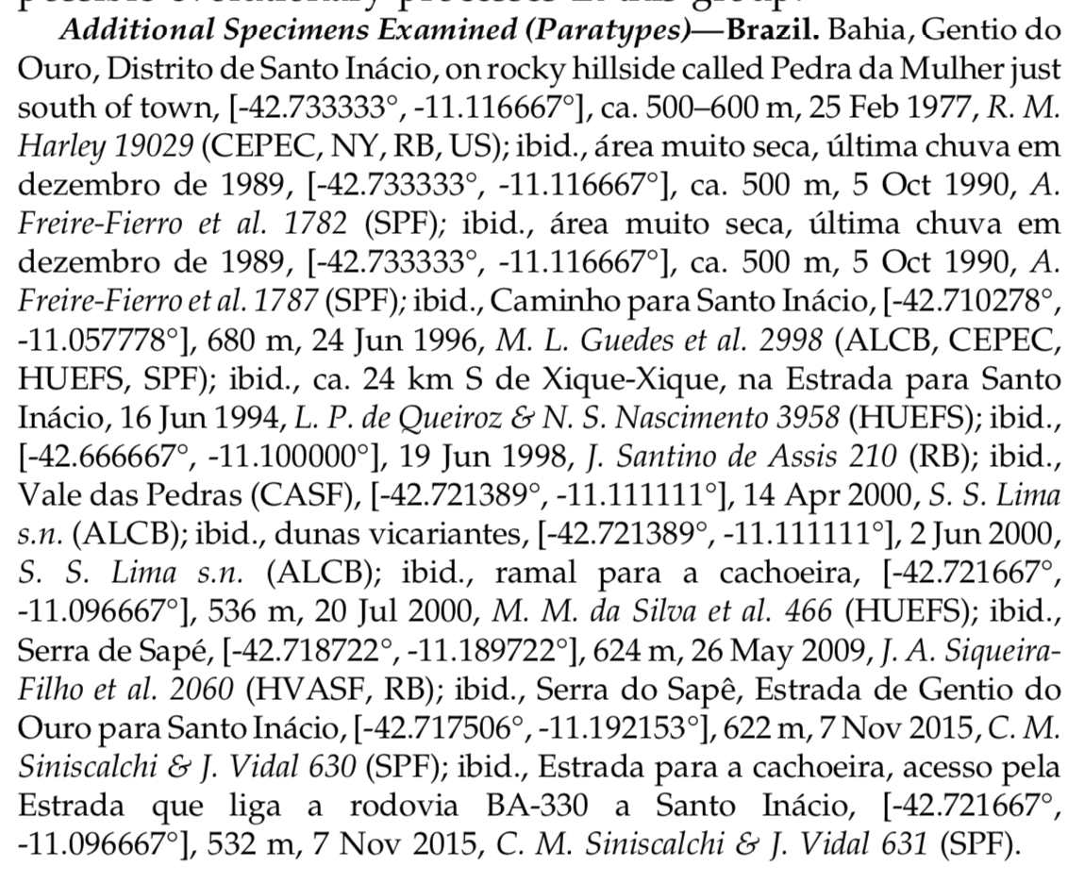
Step Two: Environmental Data
How to obtain geographical records:
2) literature review
- species descriptions (if recent)
- monographs
- floras

Slide 15
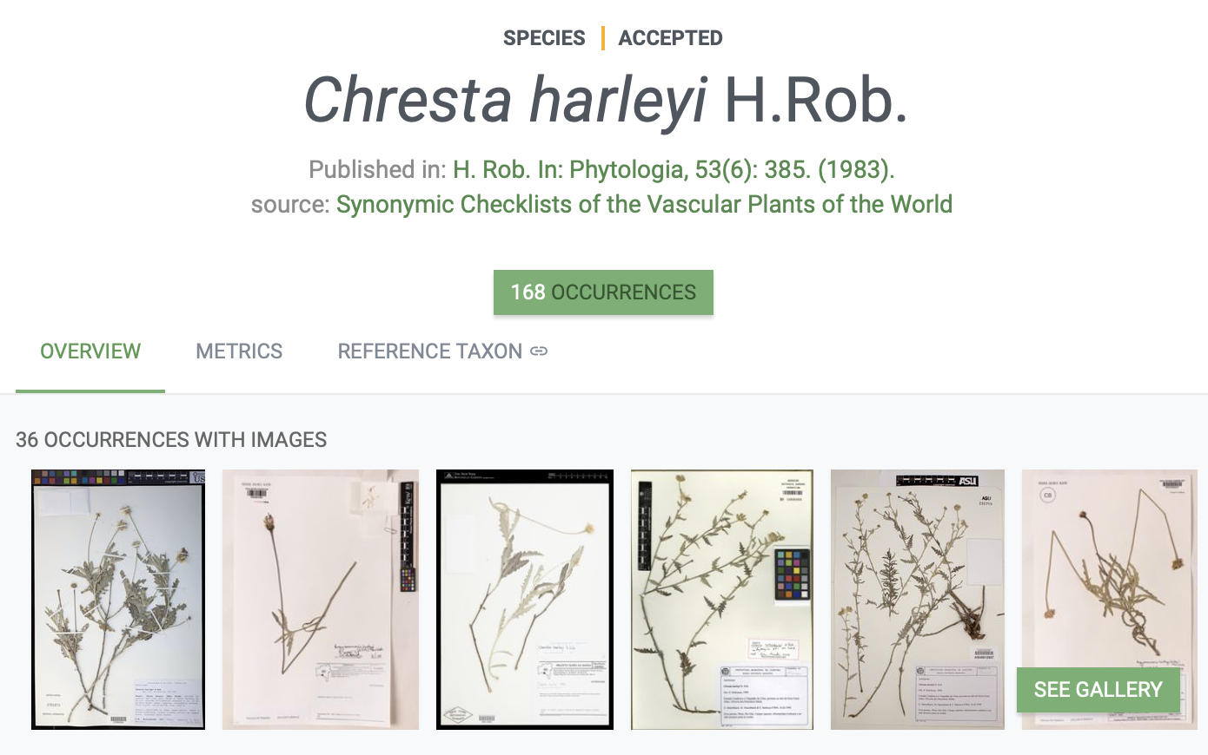
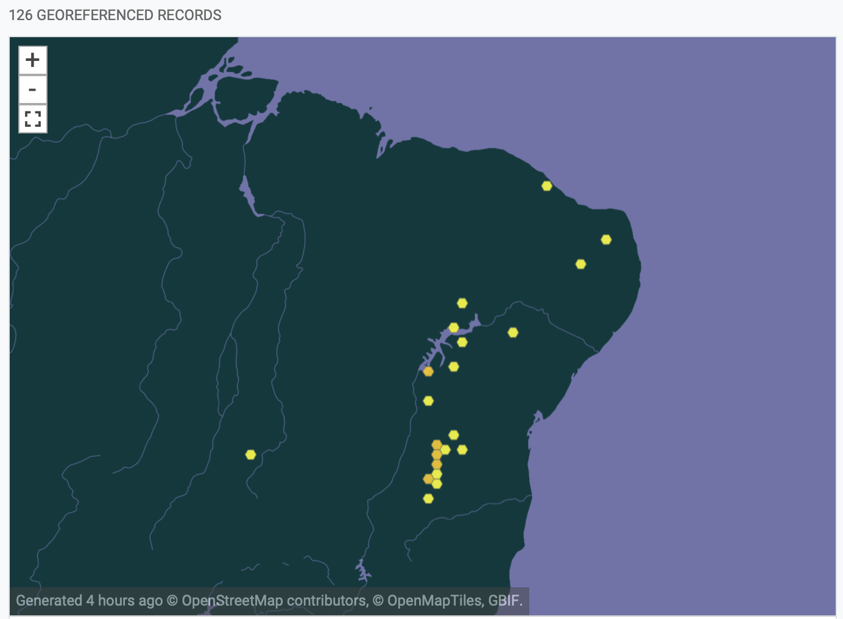
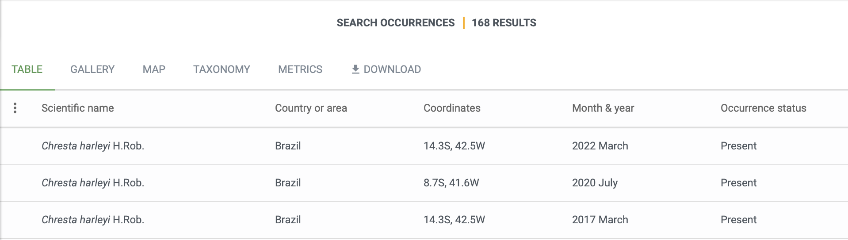
Step Two: Environmental Data
How to obtain geographical records:
3) GBIF
4) iNaturalist (GBIF pulls records from there)

Slide 16
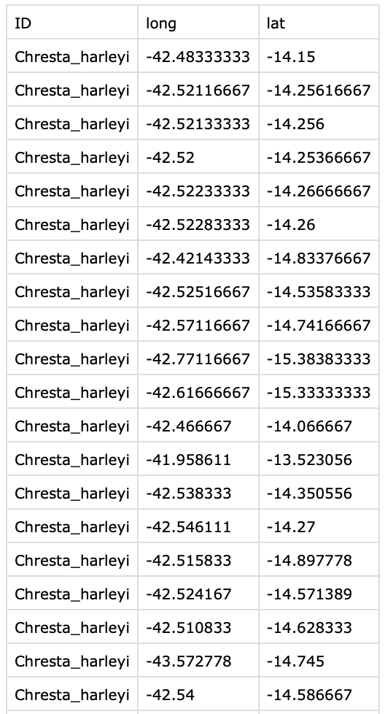
Step Two: Environmental Data
Always in decimal degrees
Record clean-up: remove duplicate values, outliers, records that fall in the wrong place (e.g., in the ocean, in the middle of a city), around botanical gardens/herbaria, etc
Always save as a .csv or .tsv file

Slide 17
Step Two: Environmental Data
OK, I have my geographical records, what now?

Slide 18
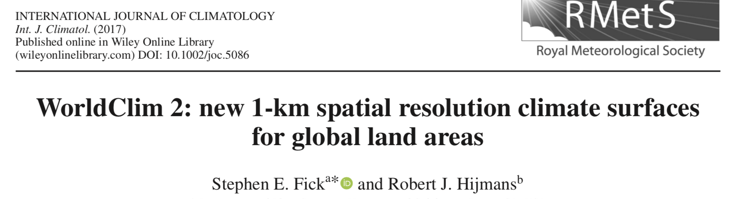
Step Two: Environmental Data
High-resolution spatial data is increasingly becoming available for different variables
BIOCLIM: 19 climatic variables – data from weather stations interpolated with satellite images, with 1 km² resolution
Format: geotiff (image file [tiff] that contains georeferencing information)

Slide 19
Step Two: Environmental Data
Other sources of spatial data:
GTOPO30: global digital elevation model (elevation, aspect, slope)
SoilGrids: global digital mapping of soil characteristics (e.g., pH, carbon, nitrogen, sand, silt and clay content)
MODIS LandCover: global land cover classification (type of vegetation)

Slide 20
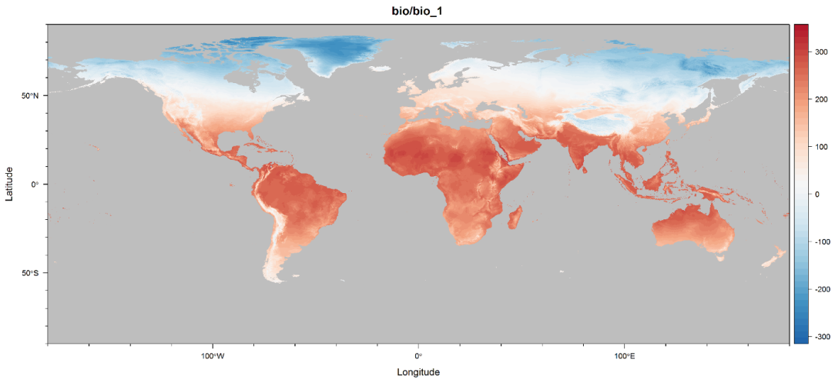


Step Two: Environmental Data
Geographical records
How it works:
annual mean temperature (ºC * 10)
Annual mean temperature: 20
Annual mean temperature: 120

Slide 21
Step Two: Environmental Data
How it works:
annual mean temperature (ºC * 10)
Look up the value of the variable in each geographical record of the species of interest
Calculate the average of the variable for that species
Rinse and repeat for all species/variables
Average species A: -5
Average species B: 80

Slide 22
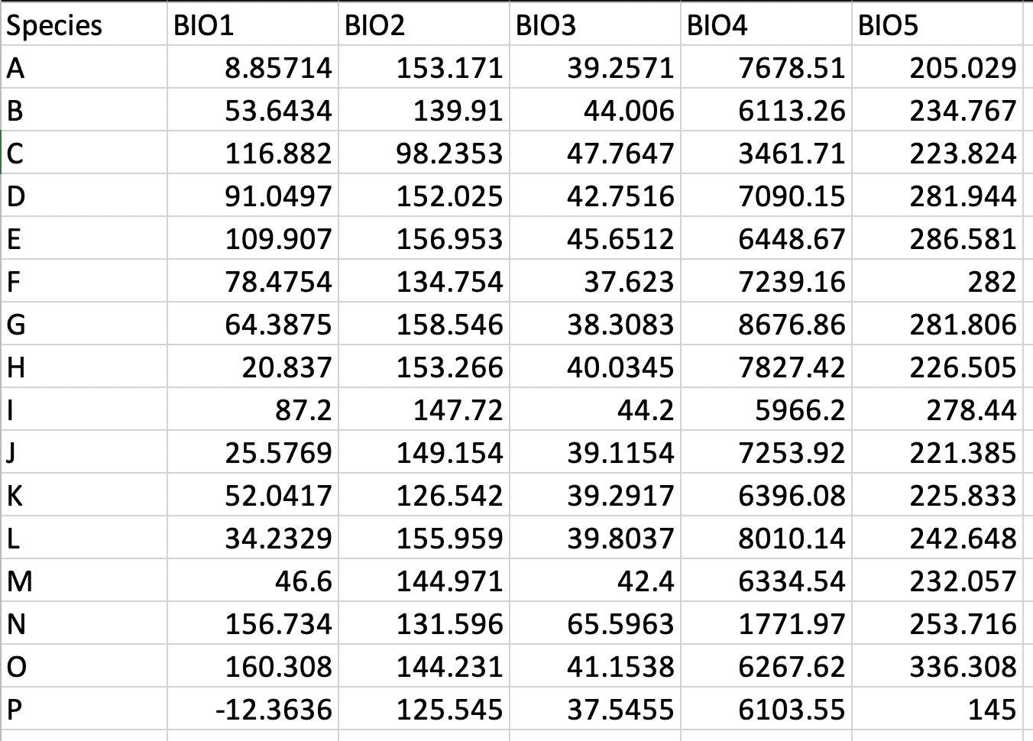
Step Two: Environmental Data
– Also possible to calculate the range (max – min) of each species
– The final result will be a comma- or tab-delimited file with the average values of all variables for all species
– This process can be automatized using custom python or R scripts

Slide 23
Step Two: Environmental Data
Species,BIO1,BIO2,BIO3,BIO4,BIO5
A,8.85714,153.171,39.2571,7678.51,205.029
B,53.6434,139.91,44.006,6113.26,234.767
C,116.882,98.2353,47.7647,3461.71,223.824
D,91.0497,152.025,42.7516,7090.15,281.944
E,109.907,156.953,45.6512,6448.67,286.581
F,78.4754,134.754,37.623,7239.16,282
G,64.3875,158.546,38.3083,8676.86,281.806
H,20.837,153.266,40.0345,7827.42,226.505
I,87.2,147.72,44.2,5966.2,278.44
J,25.5769,149.154,39.1154,7253.92,221.385
K,52.0417,126.542,39.2917,6396.08,225.833
L,34.2329,155.959,39.8037,8010.14,242.648
M,46.6,144.971,42.4,6334.54,232.057
N,156.734,131.596,65.5963,1771.97,253.716
O,160.308,144.231,41.1538,6267.62,336.308
P,-12.3636,125.545,37.5455,6103.55,145
–comma-delimited file (.csv)
– each line is a row of the table
– columns separated by commas
– if you need to look at the values in a .csv file, it’s easier to open them in excel

Slide 24
Macroevolution
Step Three: Trait Data

Slide 25
Step Three: Trait Data
In macroevolutionary studies, we select traits that could potentially explain evolutionary processes in our group of interest, such as increased diversification and occupation of new habitats.
Some examples:
Ancient and current polyploidy
Morphological changes that impact pollination and pollinator type
Changes in photosynthesis metabolism
Occurrence of symbiosis, like nodulation

Slide 26
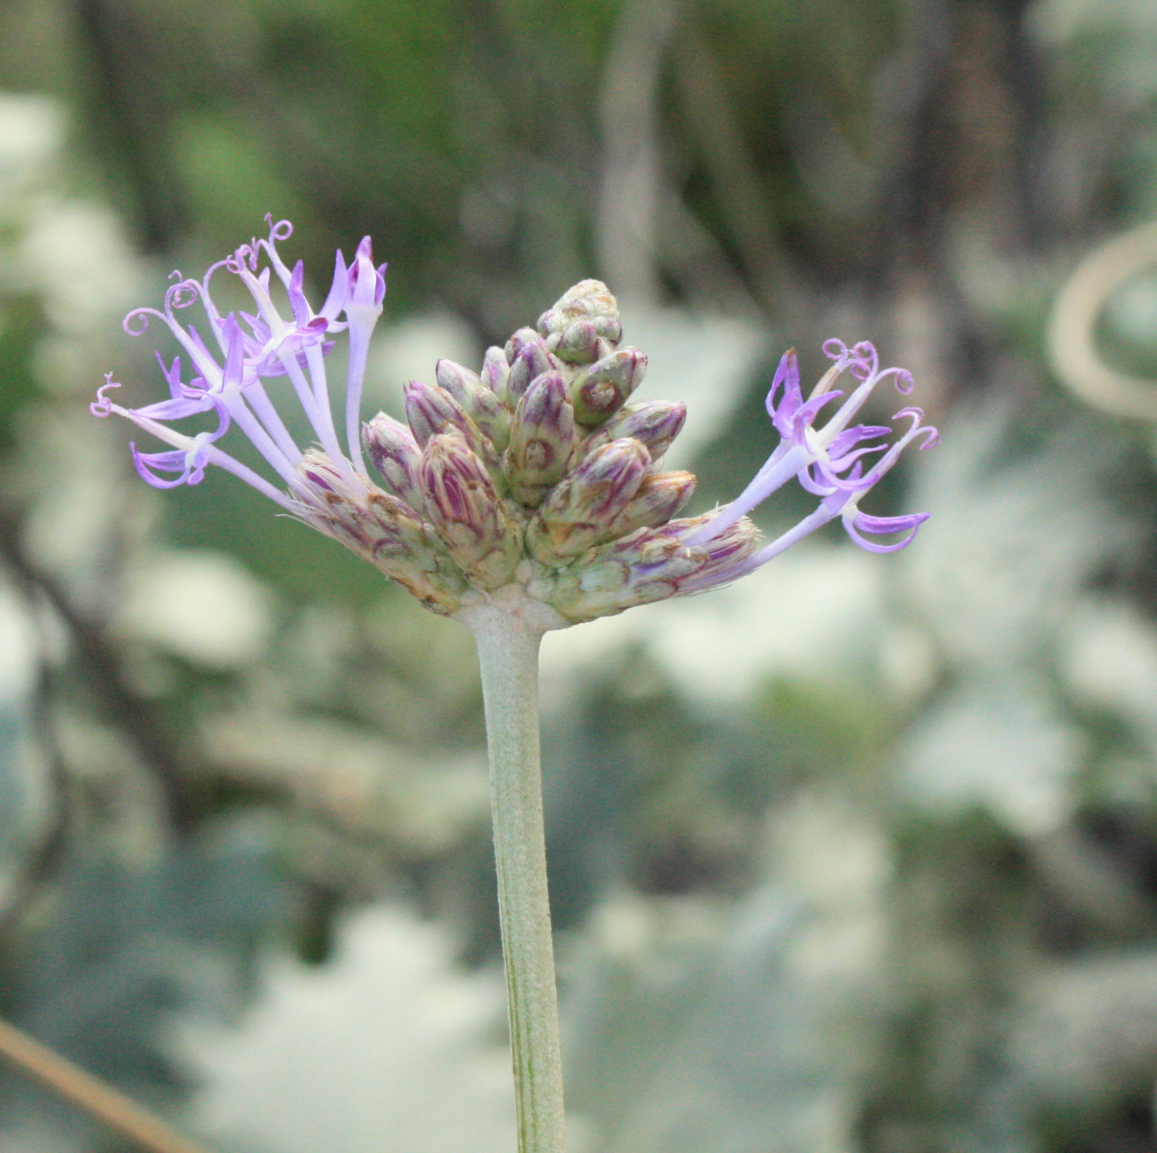
Step Three: Trait Data
Where to obtain traits?
Live and preserved specimens

Slide 27
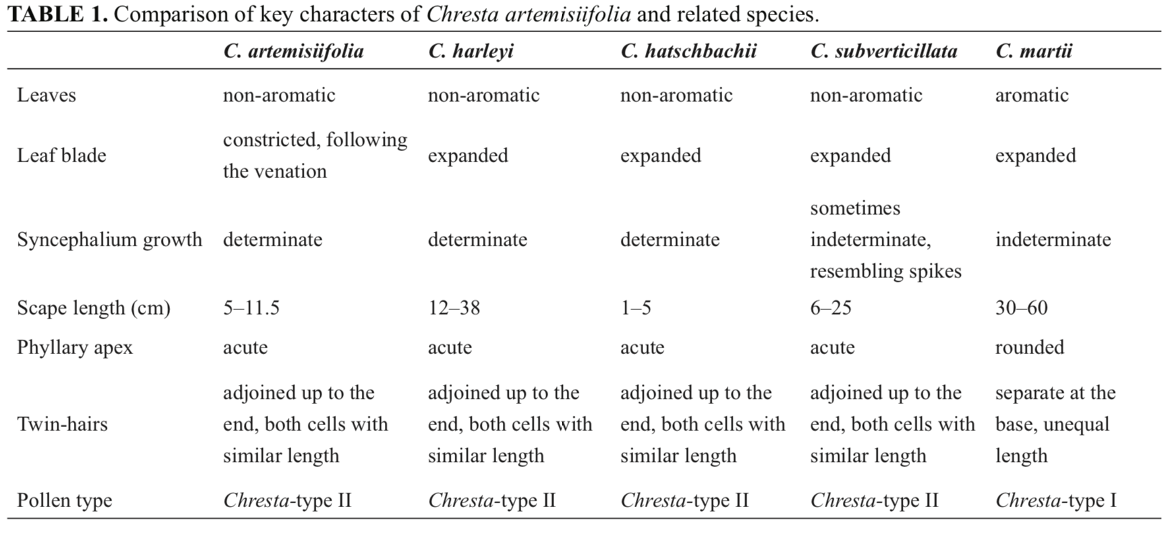
Step Three: Trait Data
Where to obtain traits?
2) Literature (monographs, floras)

Slide 28
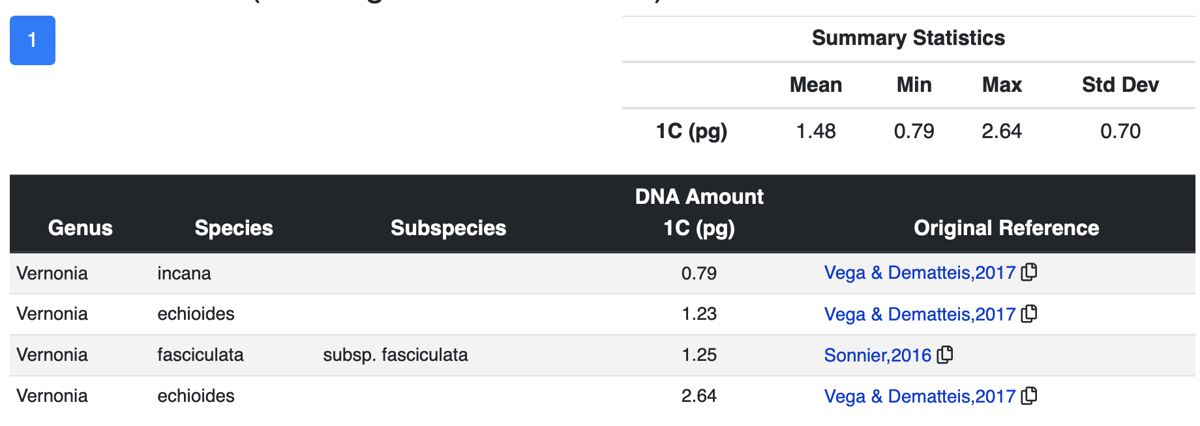
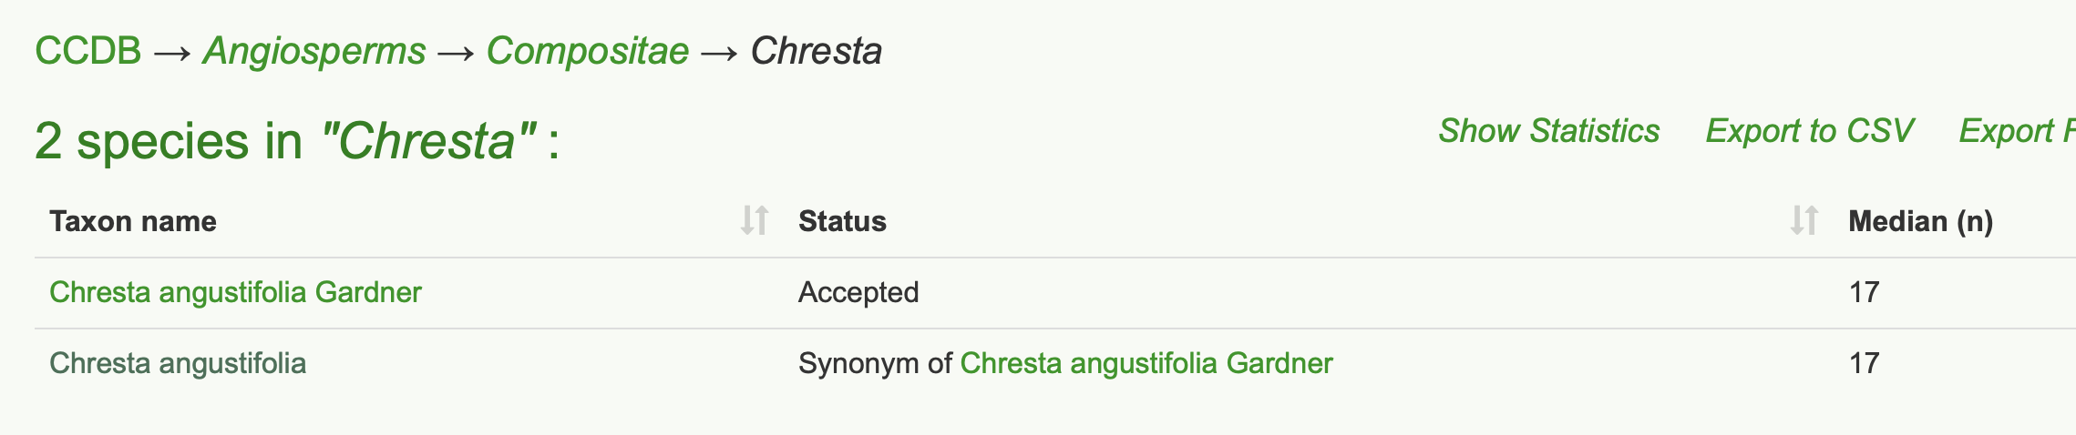
Step Three: Trait Data
Where to obtain traits?
3) Specialized databases (e.g., CCDB, genome size database)

Slide 29
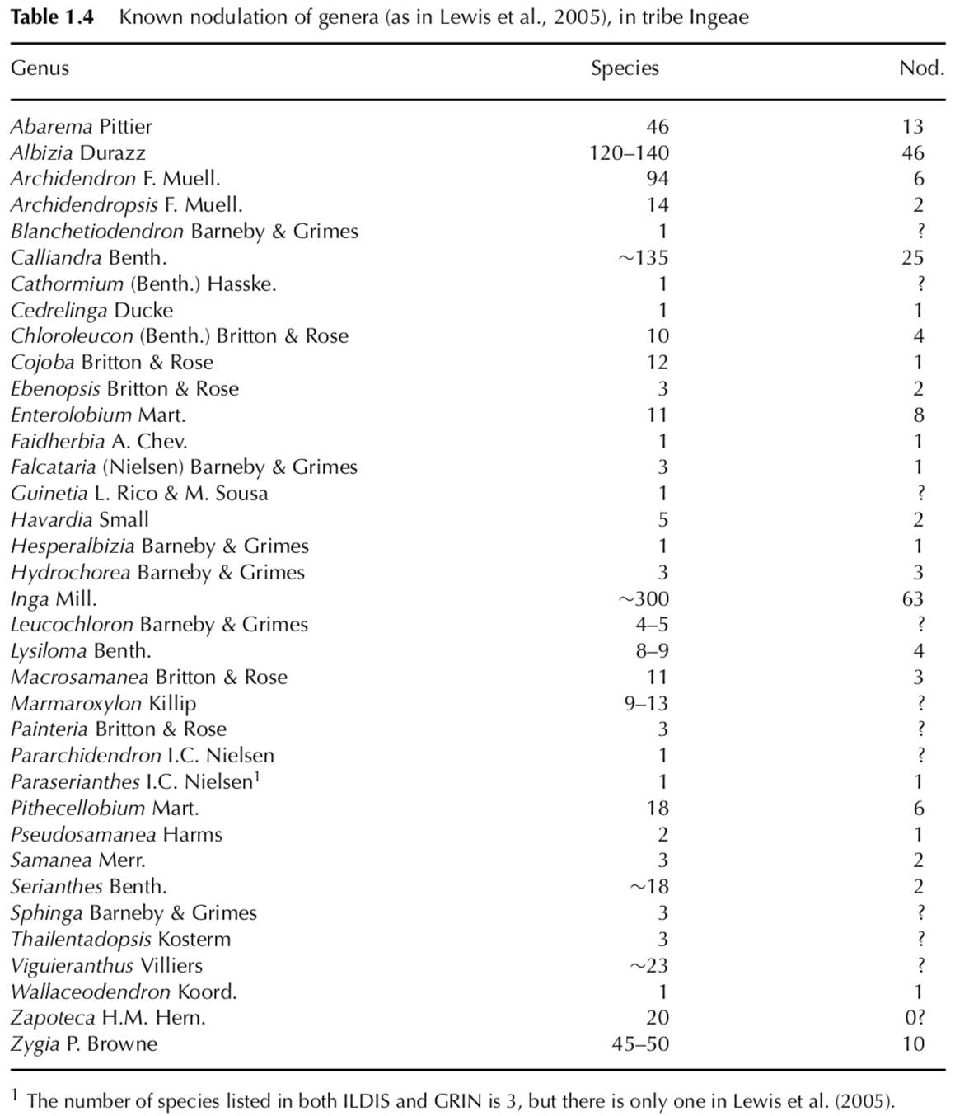
Step Three: Trait Data
Where to obtain traits?
4) Specialized literature (e.g., carbon isotope reviews, books about nodulation, etc)

Slide 30
Step Three: Trait Data
Different types of trait data:
Discrete (binary or multi-state)
Continuous

Slide 31
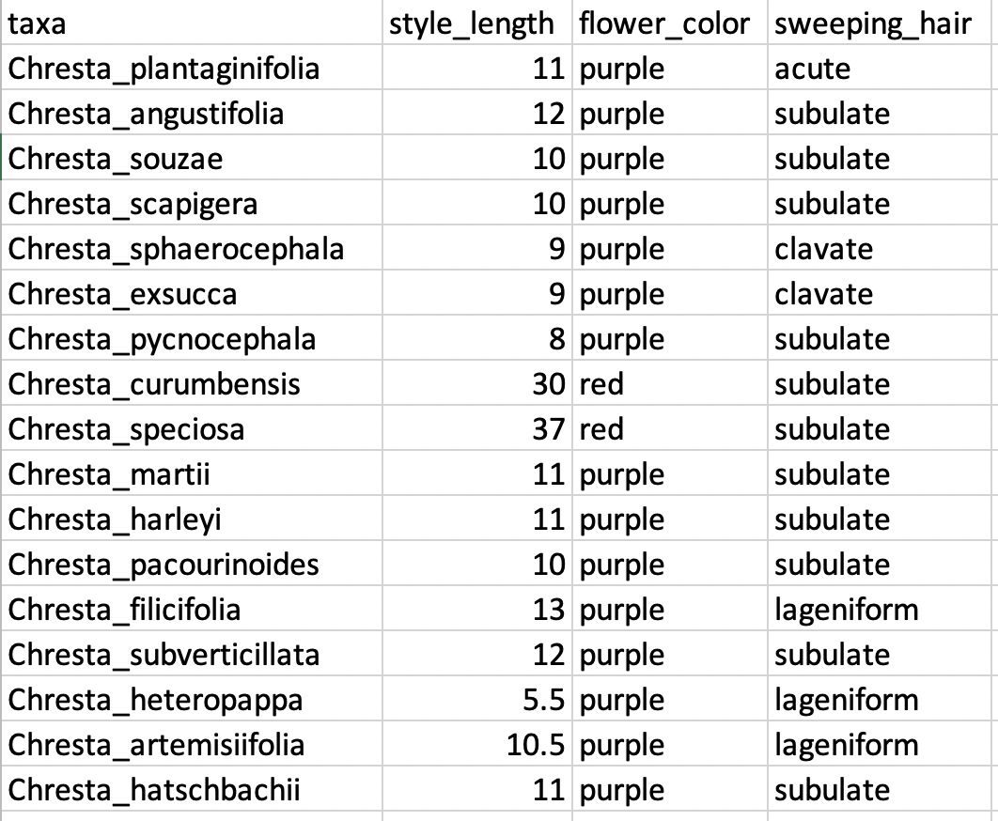
Step Three: Trait Data
Different types of trait data:
Discrete
(binary or multi-state)
Continuous

Slide 32
Step Three: Trait Data
Different types of trait data:
Discrete
(binary or multi-state)
Continuous
.csv!
No spaces between words!
taxa,style_length,flower_color,sweeping_hair
Chresta_plantaginifolia,11,purple,acute
Chresta_angustifolia,12,purple,subulate
Chresta_souzae,10,purple,subulate
Chresta_scapigera,10,purple,subulate
Chresta_sphaerocephala,9,purple,clavate
Chresta_exsucca,9,purple,clavate
Chresta_pycnocephala,8,purple,subulate
Chresta_curumbensis,30,red,subulate
Chresta_speciosa,37,red,subulate
Chresta_martii,11,purple,subulate
Chresta_harleyi,11,purple,subulate
Chresta_pacourinoides,10,purple,subulate
Chresta_filicifolia,13,purple,lageniform
Chresta_subverticillata,12,purple,subulate
Chresta_heteropappa,5.5,purple,lageniform
Chresta_artemisiifolia,10.5,purple,lageniform
Chresta_hatschbachii,11,purple,subulate

Slide 33
Step Three: Trait Data
Different types of trait data:
Discrete (binary or multi-state)
Continuous
The type of trait data will influence what type of analysis you can run
Some methods are developed thinking specifically about one type of data, and don’t apply to the other (e.g., equal-rates state reconstruction only with discrete data, phylogenetic signal methods initially developed for continuous data)
Some methods allow both types of data (e.g., PGLS)

Slide 34
Macroevolution
Now let’s get to it!

Slide 35
Macroevolution
Some questions we can ask:
Is a certain trait related to changes in diversification rates?
Are certain environmental conditions related to shifts in diversification?
Is a certain trait related to shifts to different types of environment?
Are environmental shifts related to morphological changes?
Among many others….

Slide 36
Diversification rates
What are diversification rates?
Rates at which new species form (speciation) and go extinct (extinction) – birth-death process
There are many methods available to estimate diversification rates
Fossil time series
Phylogenetic trees
γ: speciation
μ: extinction

Slide 37
Diversification rates
Diversification rates are dependent both on:
Sampling (completeness of the tree)
Branch lengths (the distance among species on the tree)
Some methods available:
BAMM (Bayesian estimation of different models of diversification)
Species-specific diversification rates (DR statistics)
MEDUSA: detect shifts in diversification in a tree (accepts incomplete trees)
γ: speciation
μ: extinction

Slide 38
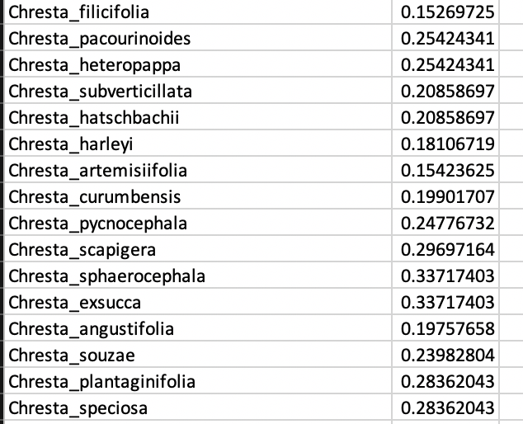
Diversification rates
Species-specific diversification rates (DR statistics)
estimate of the present-day rate of speciation or extinction for an individual lineage, conditional on past (usually recent) evolutionary history
several ways of calculating it, using information from different parts of the tree, we’ll use the method proposed by Jetz et al. 2012
γ: speciation
μ: extinction

Slide 39
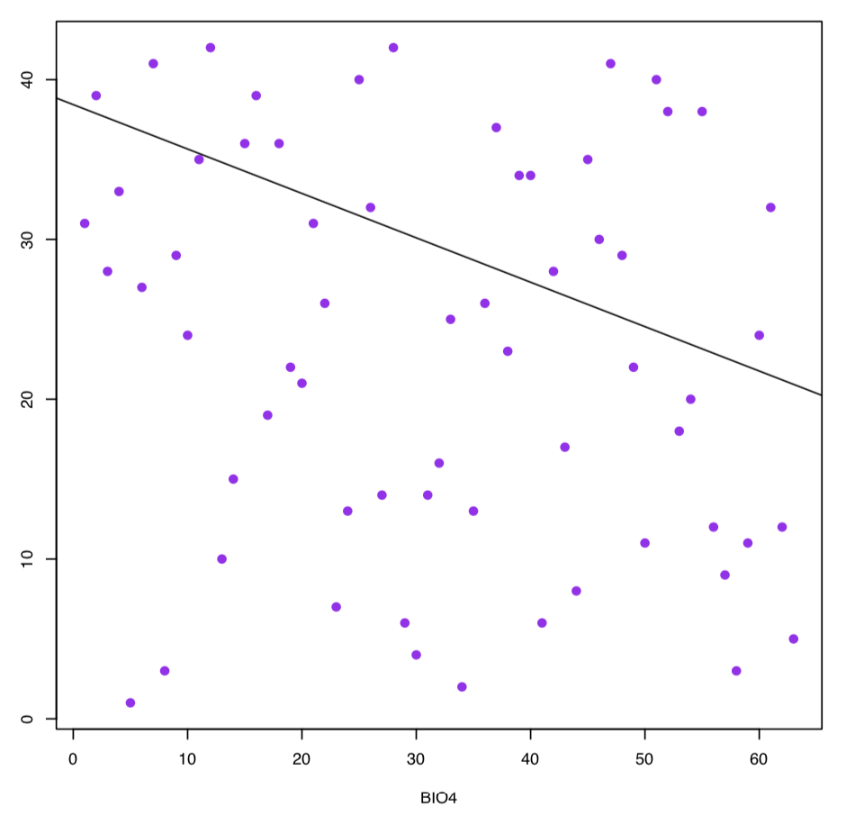
Linear regressions and PGLS
We can use regressions to investigate if two variables are correlated, e.g.,
Is floral tube length related to nectar production?
Is aridity related to diversification?
Is a polyploidy associated to the occupation of drier environments?
Is nitrogen fixation related to poor soils?

Slide 40
Linear models and PGLS
We can use linear regressions to investigate if two variables are correlated, e.g.,
Is floral tube length related to nectar production?
Is aridity related to diversification?
However, because of shared ancestry between species, they do not provide independent datapoints
Violates fundamental assumptions of several tests

Slide 41
Linear models and PGLS
PGLS is a modification of traditional generalized least squares
It assumes that closely related species will have more similar values
Accounts for specific autocorrelation due to phylogenetic history
Several ways to calculate, pgls function implemented on the R package caper
Response variable: continuous trait
Predictor variable: continuous or binary discrete data

Slide 42
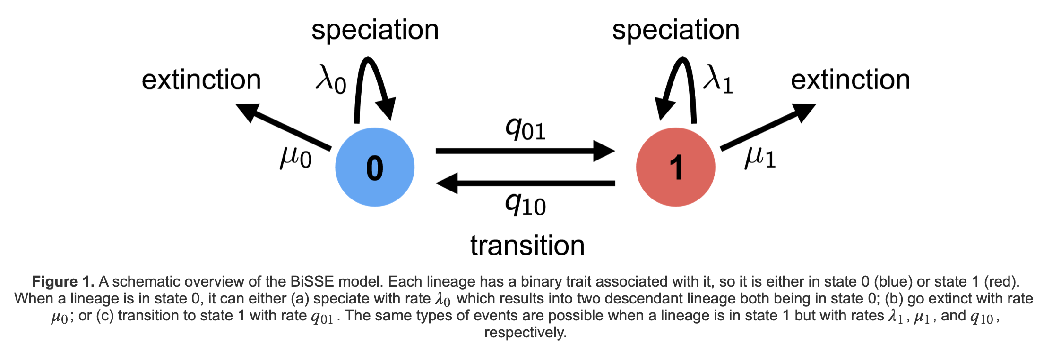
SSE Models
Character state-dependent speciation and extinction
Birth-death process where the diversification rates are dependent on the state of an evolving character
Figure from RevBayes website

Slide 43
SSE Models
Initial model (BiSSE) uses ordinary differential equations to calculate the probability of observing changes in descendent clades in a branch of a phylogeny
Only binary discrete characters
Other models were subsequently developed:
MuSSE: multistate characters
HiSSE: hiden-state speciation and extinction
ClaSSE: cladogenetic state change (biogeographic range evolution)
ChromoSSE: chromosome evolution
QuaSSE: quantitative speciation and extinction (continuous traits)
FiSSE: non-parametric test for binary characters

Slide 44
SSE Models
Initial model (BiSSE) uses ordinary differential equations to calculate the probability of observing changes in descendent clades in a branch of a phylogeny
Only binary discrete characters
Other models were subsequently developed:
MuSSE: multistate characters
HiSSE: hiden-state speciation and extinction
ClaSSE: cladogenetic state change (biogeographic range evolution)
ChromoSSE: chromosome evolution
QuaSSE: quantitative speciation and extinction (continuous traits)
FiSSE: non-parametric test for binary characters

Slide 45
SSE Models
Several models implemented on the R package diversitree or on their own packages (e.g., hisse)
Several models also implemented on RevBayes (great intro on SSE methods here: https://revbayes.github.io/tutorials/sse/bisse-intro.html)
There’s been some criticism of some of these methods, due to concerns of sensitivity to model inadequacy and phylogenetic pseudoreplication. Some methods were created to control these issues (e.g., FiSSE, HiSSE).

